Slide 1
Yelp Recommendation System
Collaborative Filtering
using Neural Network Embeddings
by Michael Miscanuk

Slide 2
Based on
Objective
Having chosen a Restaurant, system should recommend similar restaurant based on user ratings.
Trainable Embeddings via Neural Network
Dot Product
Cosine Similarity

Slide 3
A little bit of Math

Slide 4
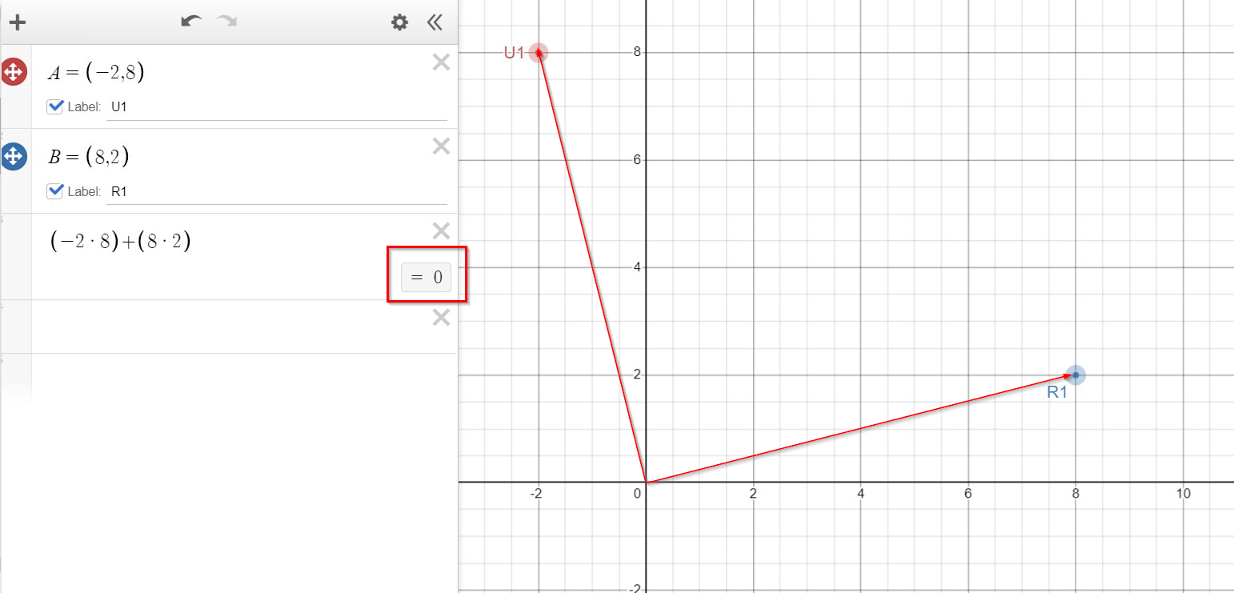
Dot Product
Orthogonal – right angle vectors: different directions
Dot product is 0

Slide 5
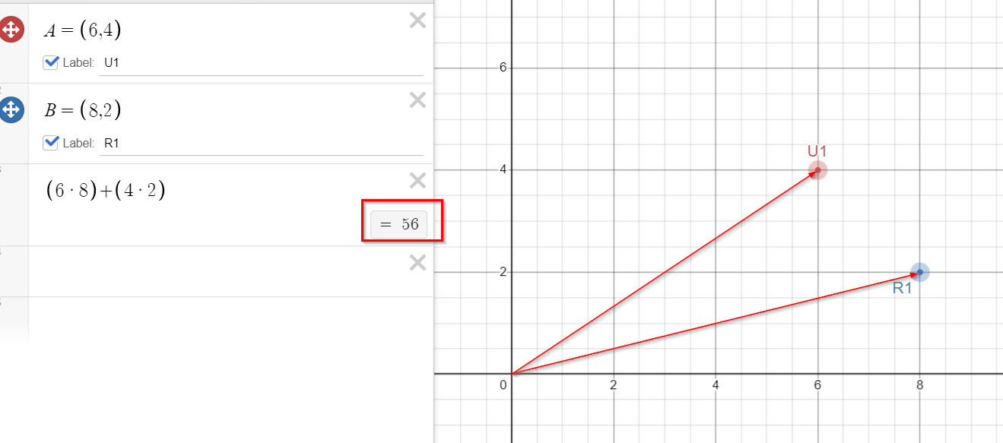
Similar directions
Dot product is higher

Slide 6
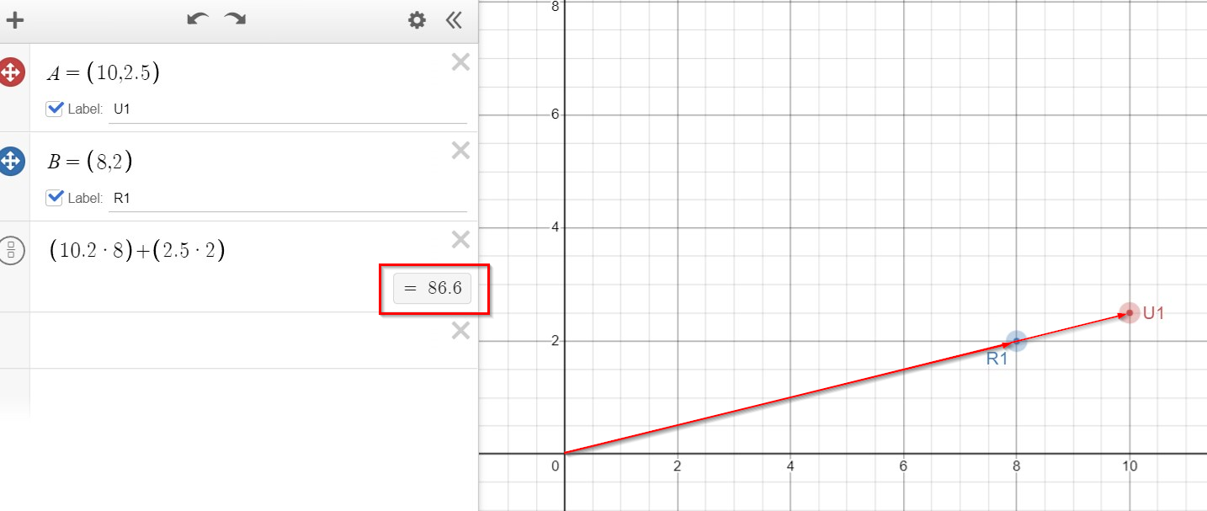
Same directions
Dot Product is Biggest

Slide 7
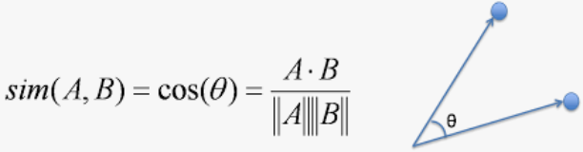
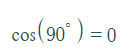
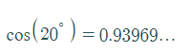
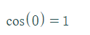
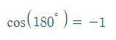
Cosine Similarity
The bigger the number – the more similar two vectors are
Range: (-1,1)
-1 means that vectors point in opposite directions

Slide 8
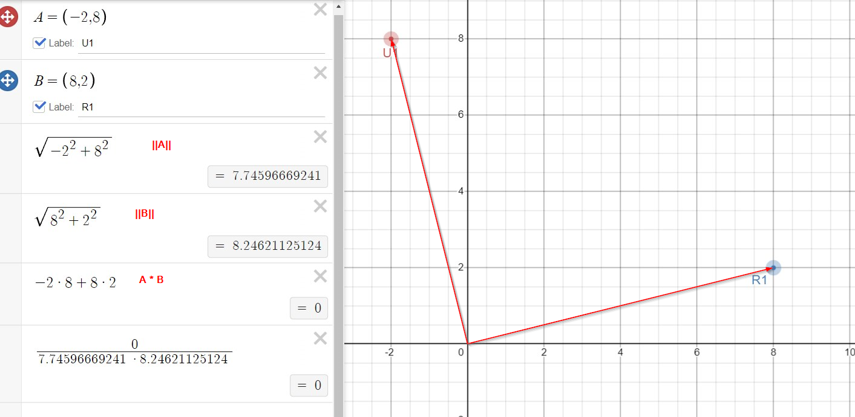
Example 1: Cosine of Right Angle Vectors

Slide 9
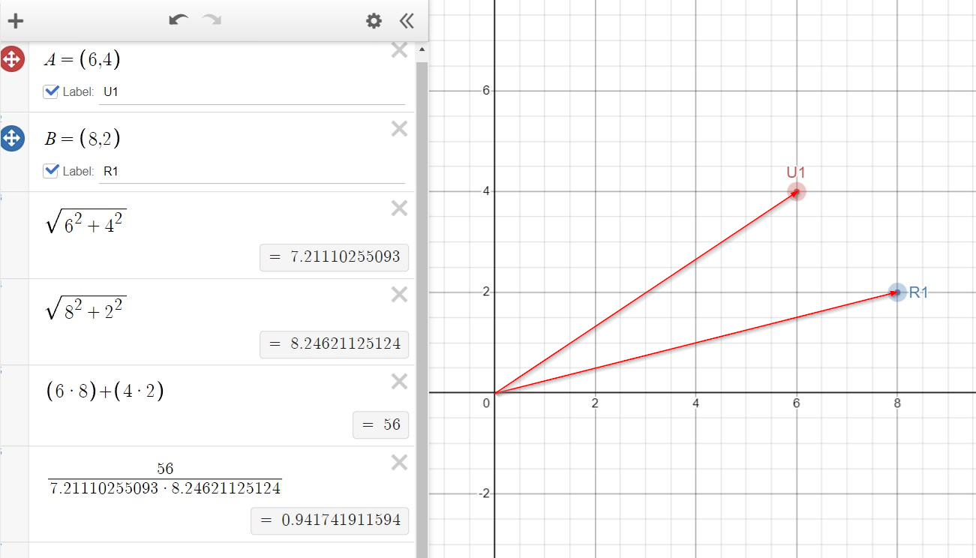
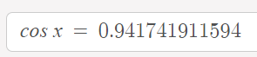
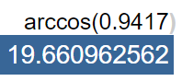
Example 2: Cosine of Nearby Vectors

Slide 10
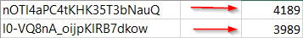
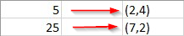
EMBEDDINGS
Embedding is a mapping table that will map a number to a vector
Each user / restaurant ID is LabelEncoded to be an integer (1,2, … )
Embedding maps an integer, say 5, to a vector, say (2,4)

Slide 11
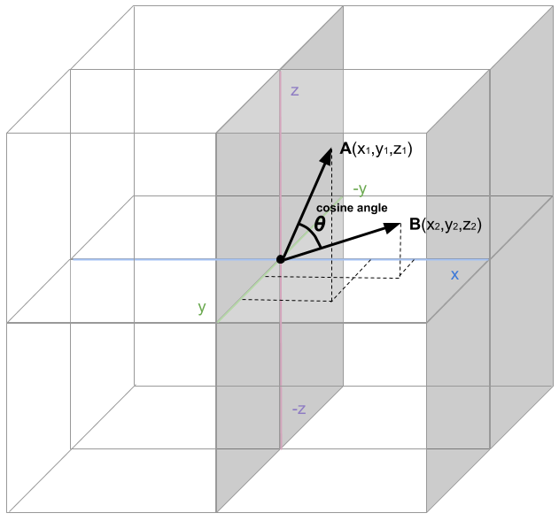
Embeddings with Neural Networks
Embeddings – values of vectors – will be trained via neural network
All concepts with similarity as in 2D will apply to more dimension
Size of dimensionality of the Embedding Space will be tweaked using hyperparameter tuning
Which means how many parts will vector have
10D vector: A = (1,5,8,6,3,2,5,8,7,8)

Slide 12
To understand how similar Restaurants will come up

Slide 13
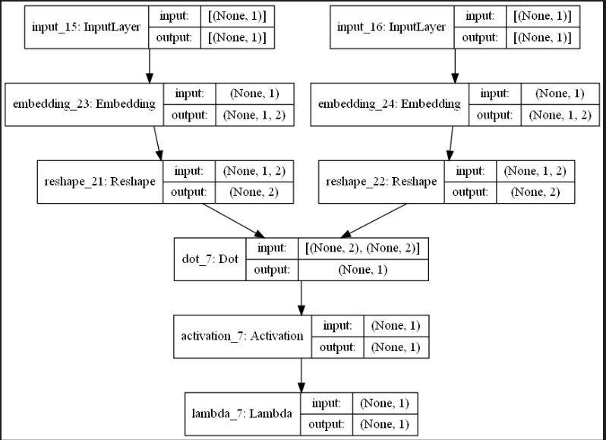
Simplest NN Architecture

Slide 14
Size of embedding space is the same for users and for restaurants
Dot Product is done between the user and the product
We train the embeddings for each user and embeddings for each restaurant - in such a way - that the predicted ratings will be as close as possible to the real ratings – of users given to the restaurant
Will have lowest loss (e.g. mean squared error)

Slide 15
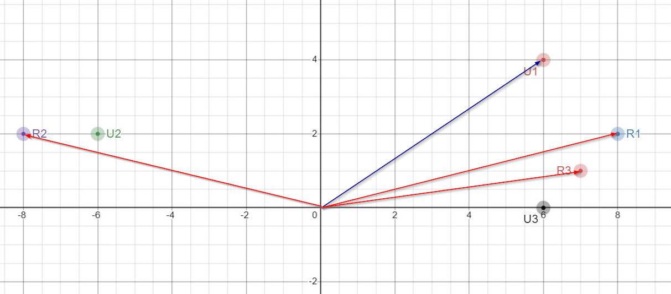
Example
Imagine we trained a model, and achieved lowest possible loss – embedding are now trained and final
So the vectors ended up like on the picture
We have 3 users and 3 restaurants
Every user rated every other restaurant (in this example)
User U1 liked Restaurant R1, say by giving it rating it 5. So they point in similar direction;
User U1 liked restaurant R3 a little less; say by giving it rating 4
User U1 disliked restaurant R2 by giving it rating 2
Similarly for others

Slide 16
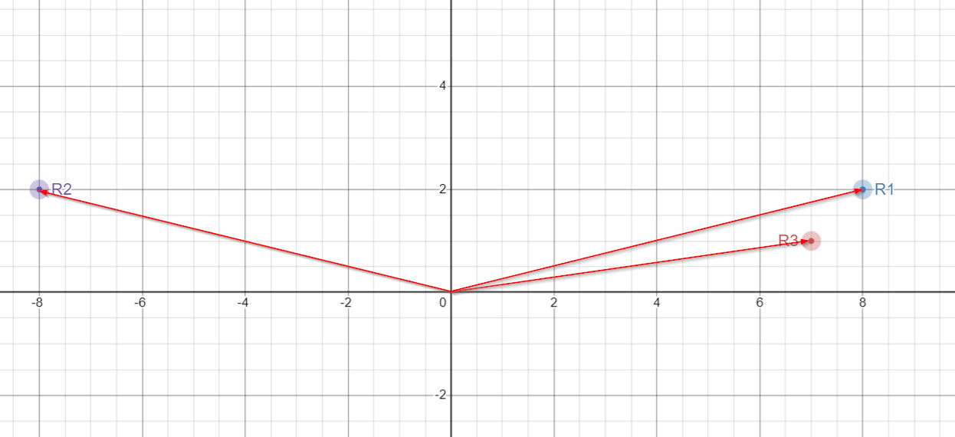
To make recommendations we look only on embeddings (vectors) of the restaurants
We want to find similar restaurant to restaurant R1 based on user ratings.
Which one will it be? R2 or R3
Two users liked restaurant R1: user U1 and user U3
These both users also liked restaurant R3, and both of them disliked restaurant R2
So the most similar restaurant to restaurant R1 is restaurant R3

Slide 17
Implementation Details
EDA

Slide 18
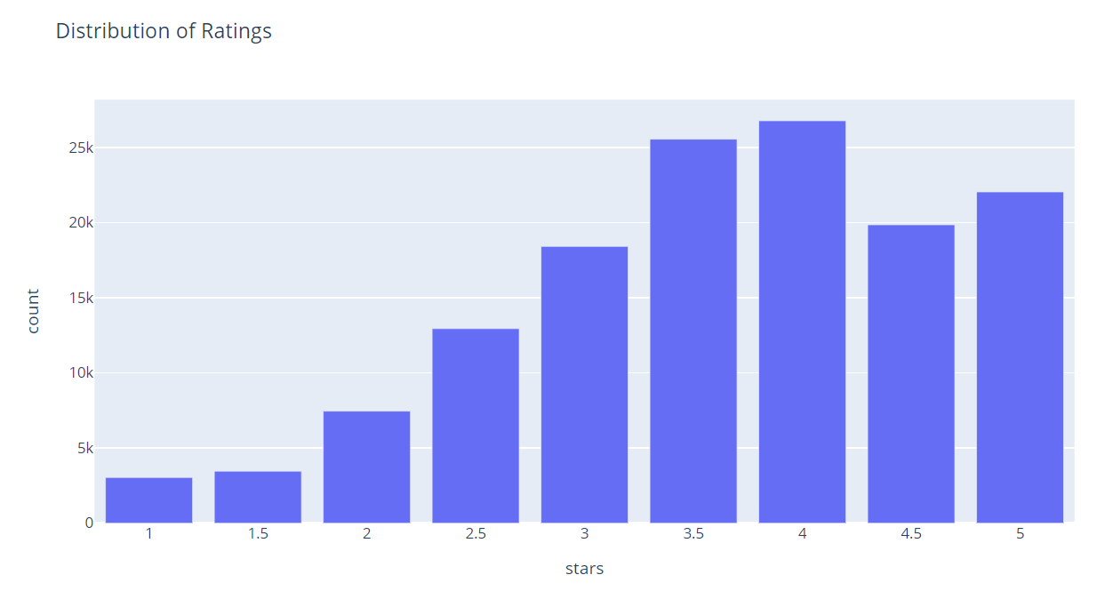
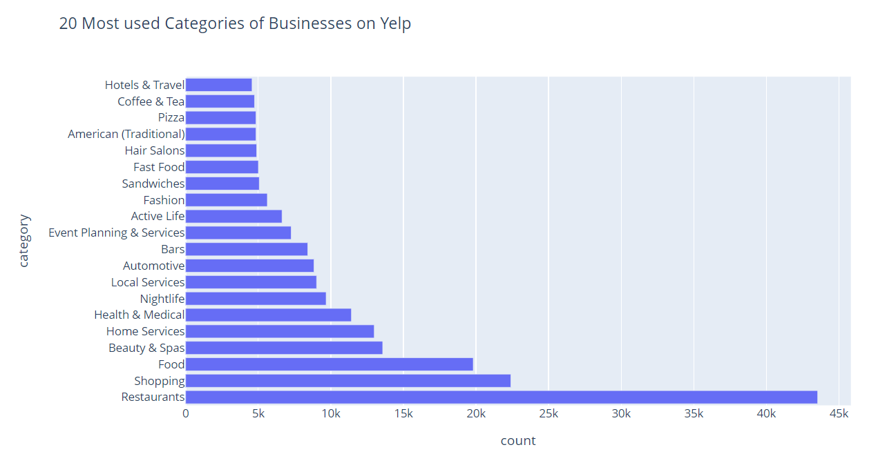
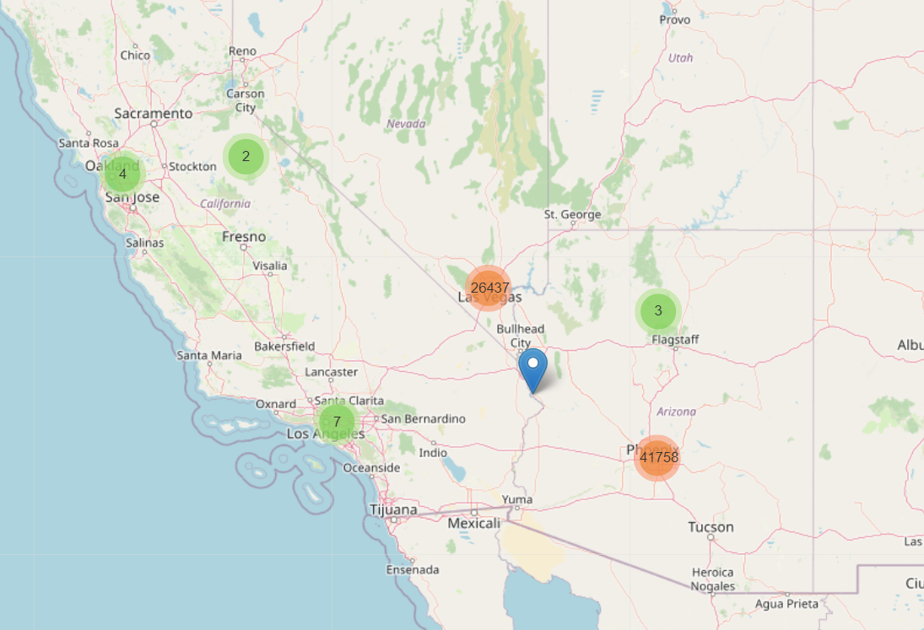
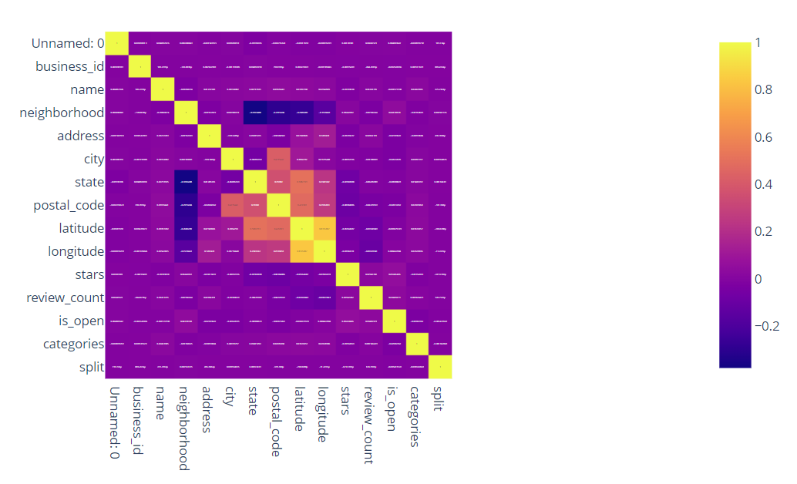
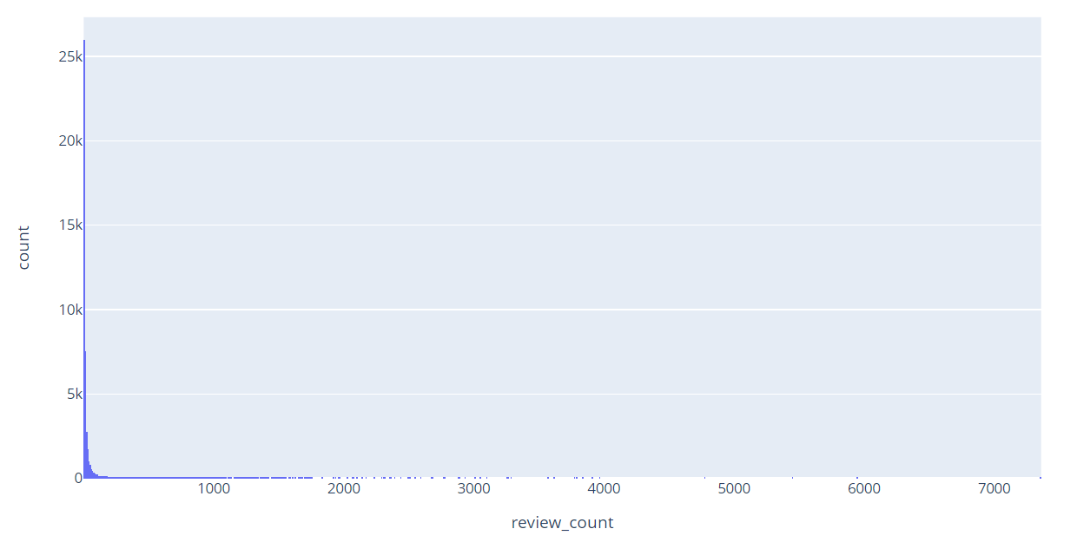
EDA Outputs: Business

Slide 19
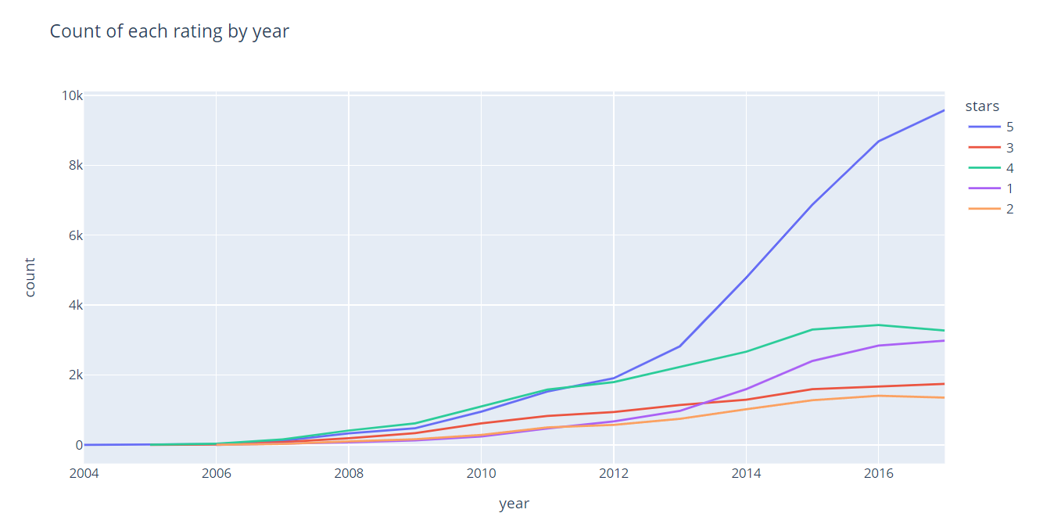
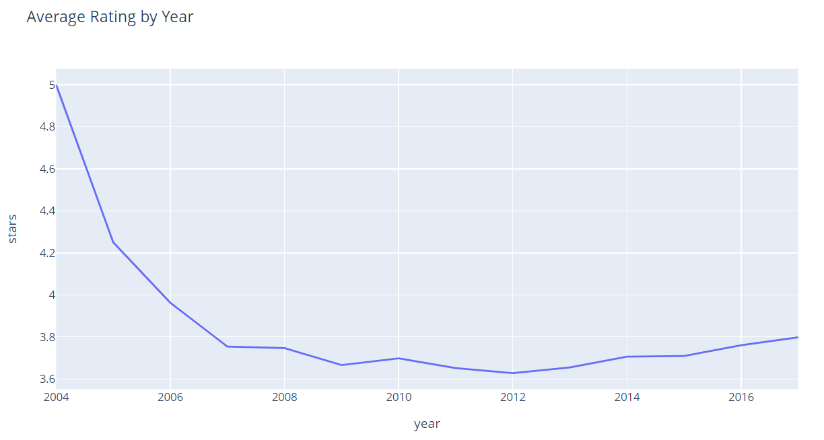
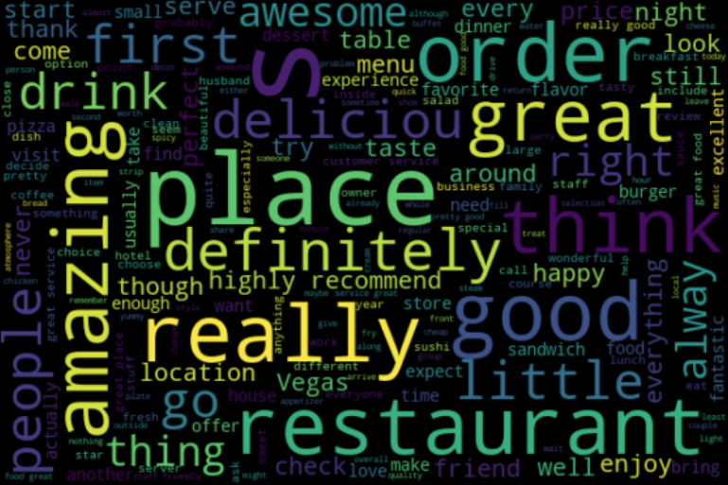
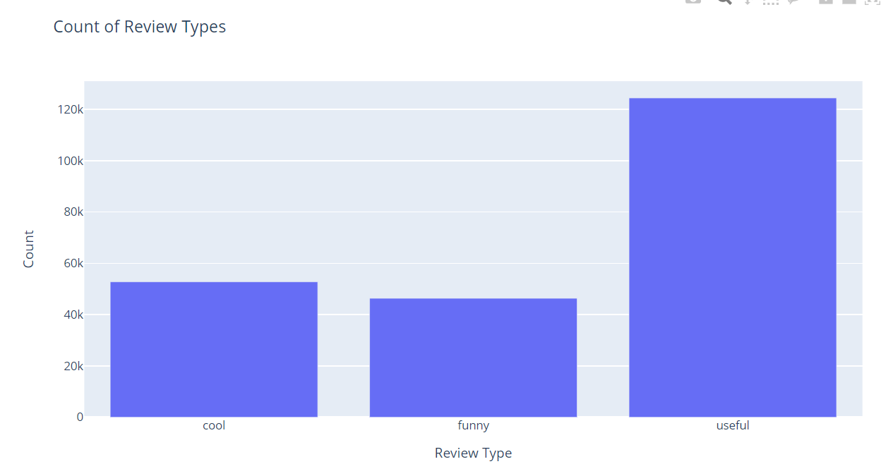
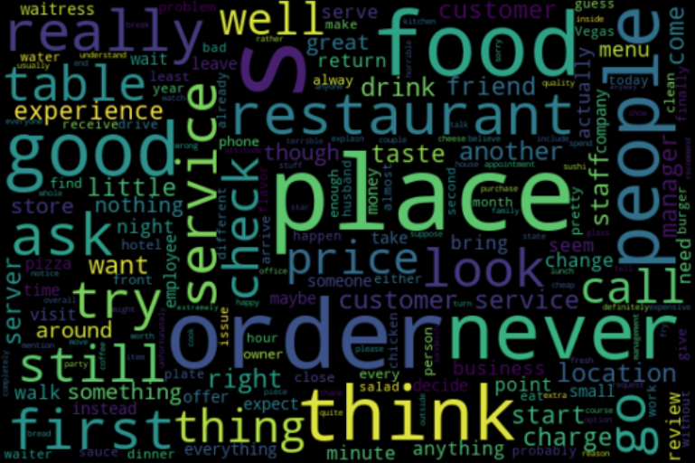
EDA Outputs: REVIEWS

Slide 20
Algorithm

Slide 21
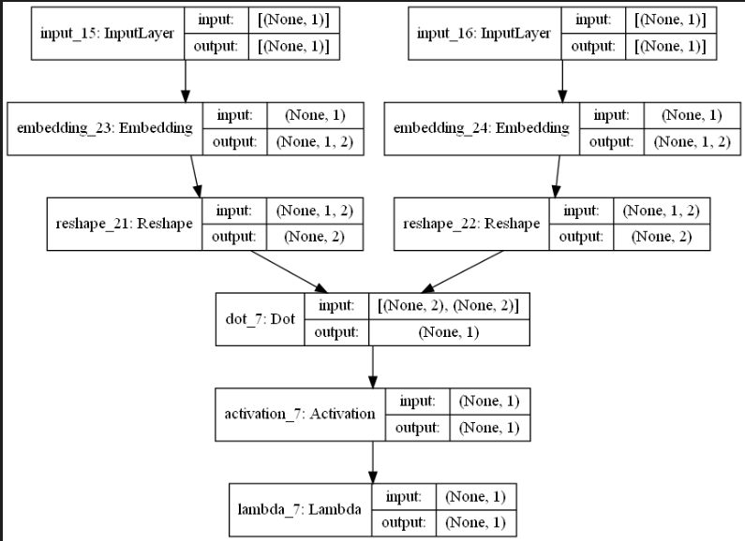
Simplest Model
"None" in the picture stays for the size of the batch. Lets say batch is 1
On first iteration Input is some user number, say 5; and also some restaurant number, say 10
User number 5 is changed by Embedding layer to a vector of size 2 (after reshaping); e.g. (1,2);
(Why reshaping: Embedding layer outputs a matrix of one row and 2 columns; but we want a vector of size 2)
Components of a vector will be trained by neural network to achieve best performance (lowest loss function)
Restaurant number 10 is changed say to a vector (5,7)

Slide 22
Vector of size 2 is DOT MULTIPLIED by vector of size 2; e.g. (1,2) * (5,7) = 1*2 + 2*7 = 2 + 14 = 16
16 is input to the sigmoid function which outputs a number between 0 and 1, specifically sigmoid(16) = 0.9999998874648379
0.9999998874648379 is min max scaled to the range <1,5> and returns 4.999999549859352, which is the prediction that this user 5 gave to the restaurant 10

Slide 23
this prediction is compared to the actual rating that this user 5 gave to the restaurant 10, say actually he rated it 4
error now is 4.999999549859352 - 4 = 0.999999549859352 (it is also squared to get 0.99999909971)
After many iterations all those errors for all pairs of user/restaurant are aggregated to get the mean square error, which is our loss.
This loss is used in backpropagation to adjust the embedding vectors in such a way that the loss will be reduced by small amount
Repeat iterations by another batch.

Slide 24
TUNING

Slide 25
Bias
Different Embedding Space size
More Data
Dropout
Alpha Dropout
Early Stopping
Model Saving
Grid Search
Cross Validated Grid Search
Batch Normalization

Slide 26
Final Model

Slide 27
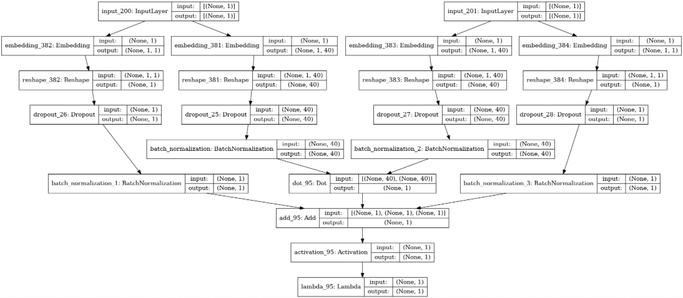

Slide 28
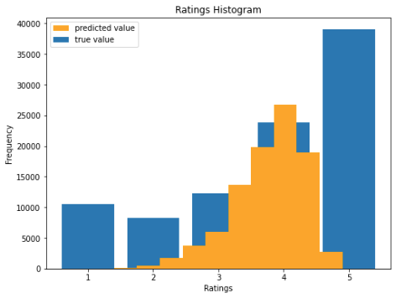
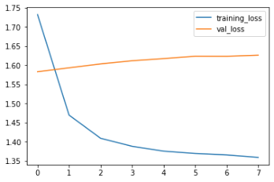

Slide 29
Using Model: Similarity Table

Slide 30
